Slide 1
EXPENSE MANAGEMENT SYSTEM
A USER FRIENDLY WEB APPLICATION FOR MANAGING EXPENCES
GROUP - 2
1. | H YASHWANTH
2. | ARPIT SHARMA
3. | ARUL G
4. | SUHAS SHINDE
5. | HARISH M
6. | TEJA SRI BONAGIRI

Slide 2
ABSTRACT
Overview: The Expense Management System is designed to streamline the process of tracking, managing, and analyzing organizational expenses. It helps companies ensure transparency, comply with corporate policies and tax regulations, and eliminate manual monitoring. The system, built using a monolithic architecture, ensures scalability and flexibility by dividing the application into distinct modules such as User Authentication, Expense Management, Category Management, Report Generation, and Notifications. Each module caters to a specific functionality, ensuring the smooth operation of the system.
Key Features:
User Module: Secure user registration, login, and role-based dashboard access with email verification.
Expense Module: Interface for adding, updating, and managing expenses with backend validation.
Category Module: Categorization of expenses with category-wise dashboard and reports.
Category Module: AI-powered categorization of expenses with category-wise dashboard and reports.
Notification Module: Real-time expense notifications and secure backend notification management.
Feedback and Email Notification: AI-driven email/SMS notifications for key events like expense thresholds and user feedback.

Slide 3
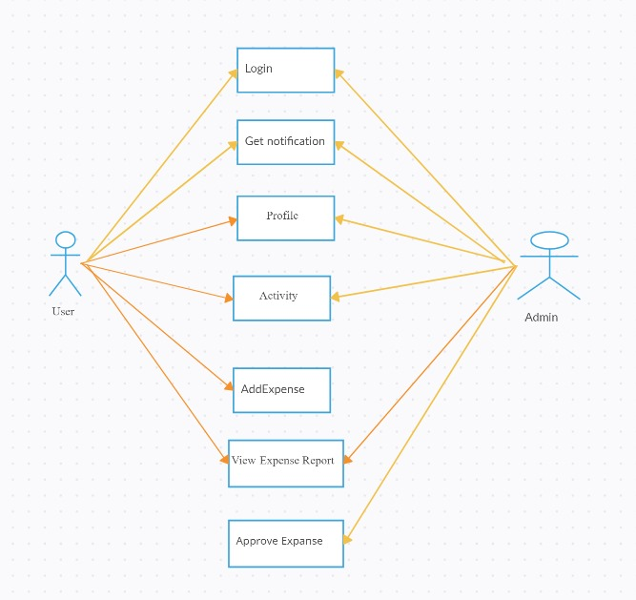
USE CASE DIAGRAM

Slide 4
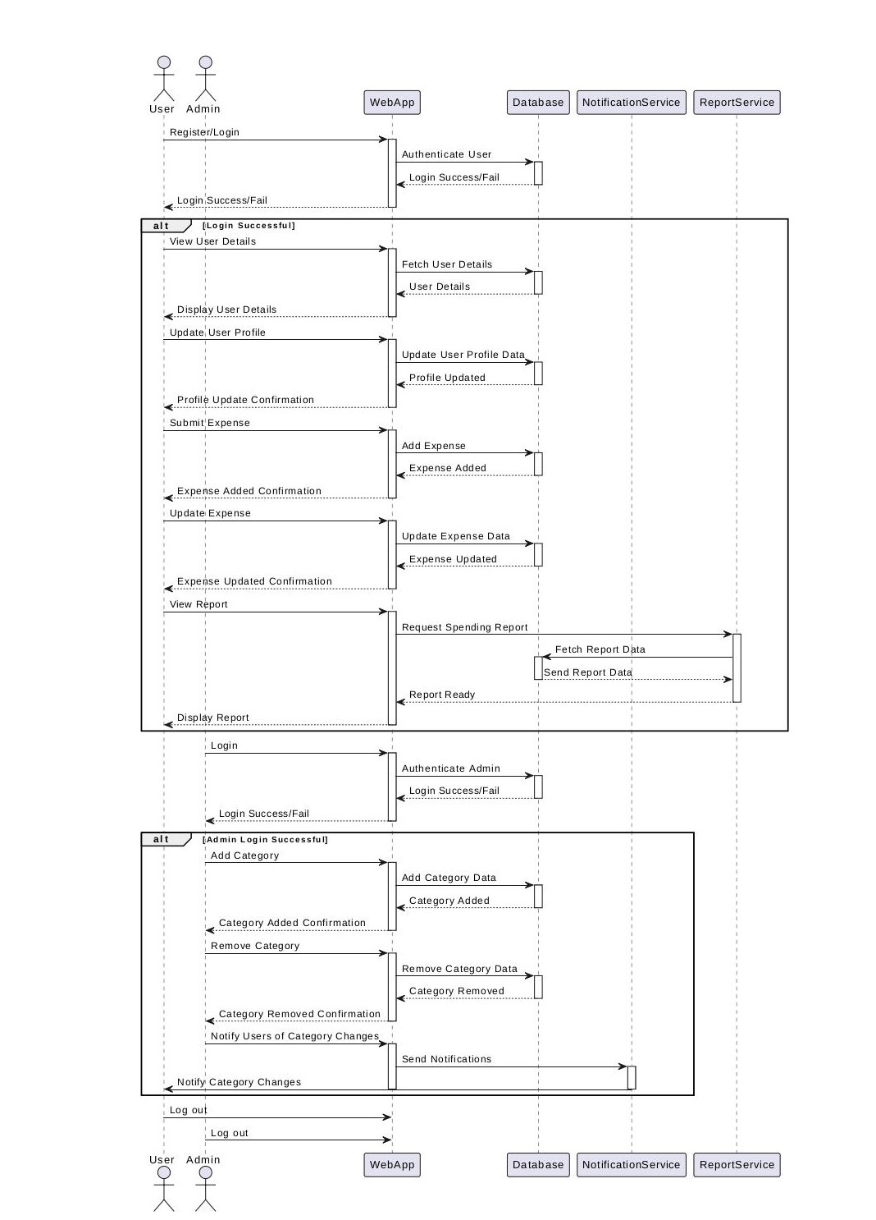
SEQUENCE DIAGRAM

Slide 5
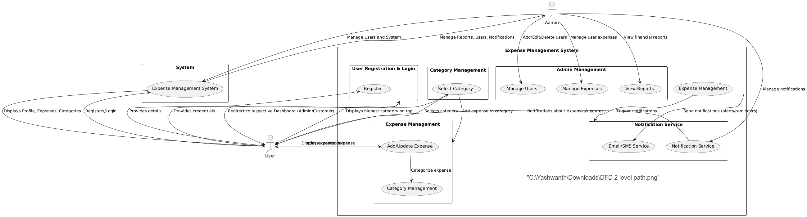
DATA FLOW DIAGRAM

Slide 6
SOFTWARE REQUIREMENTS
1)Web Browser:
Google Chrome (recommended for optimal performance with React-based apps)
Mozilla Firefox
Safari
Microsoft Edge
Browser Version: A recent version of any of these browsers (latest stable release) is recommended. Make
sure JavaScript and cookies are enabled.
2)Internet Connection:
Speed: A stable broadband connection (at least 2 Mbps) is recommended for smooth use.
Browser Compatibility: Ensure that JavaScript is enabled on the browser for the React app to work correctly.
3)Operating System (Web app should work across most platforms):
Windows (Windows 7 or newer)
macOS (macOS X 10.10 or newer)
Linux (Ubuntu or other major distributions)
Chrome OS (if using Chromebooks)

Slide 7
HARDWARE REQUIREMENTS
1) Device:
Desktop/Laptop:
CPU: Any modern multi-core processor (Intel Core i3/Ryzen 3 or better)
RAM: 4 GB minimum (8 GB recommended for smooth multitasking)
Storage: 1 GB of free space (for caching and browser-related data)
Display: A screen resolution of at least 1366x768 (higher resolutions like 1920x1080 for better experience)
Mobile Devices (if the app is responsive or has a mobile version):
Operating System:
Android (5.0 Lollipop or newer)
iOS (iOS 11 or newer)
Display: Smartphone with at least 4.5-inch screen size and minimum 720p resolution (1280x720)
RAM: 2 GB or higher for smooth usage
Browser: The latest version of Chrome, Safari, or Firefox
2)Peripherals (Optional):
Keyboard and Mouse for navigation (especially on desktops or laptops).
Touchscreen for mobile and tablet users to interact with the app easily.

Slide 8
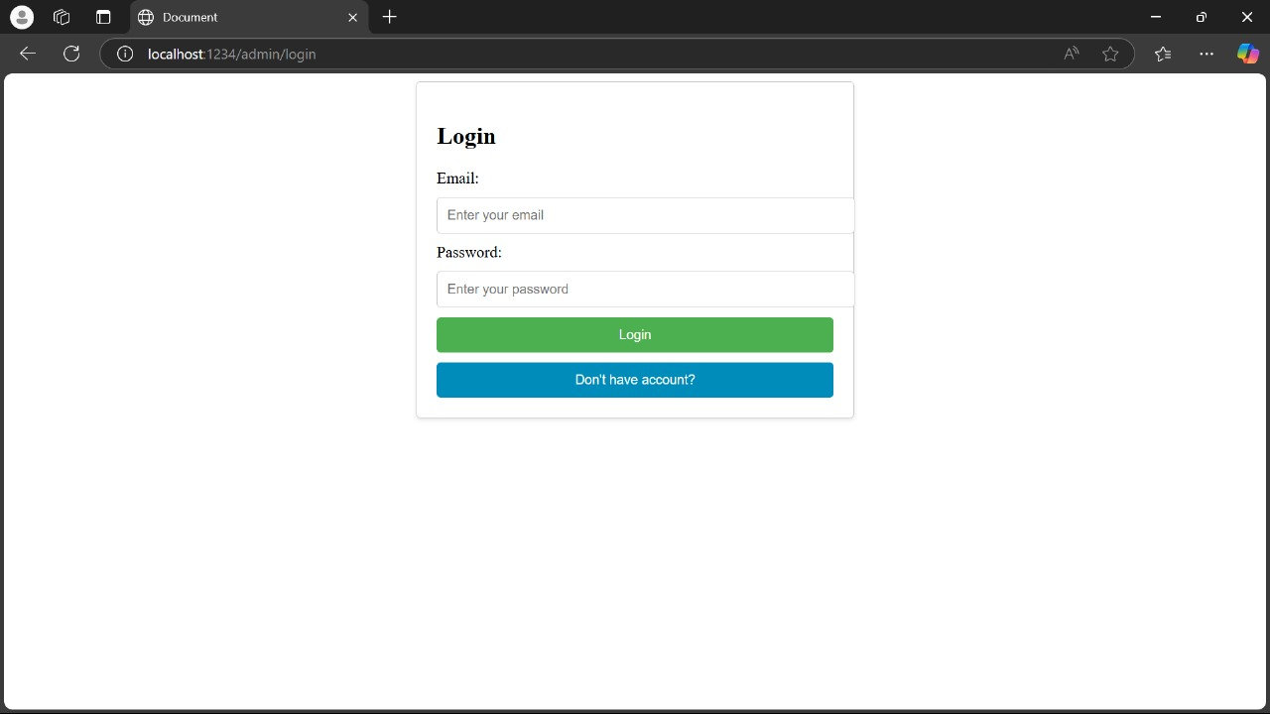
FORM DESIGN

Slide 9
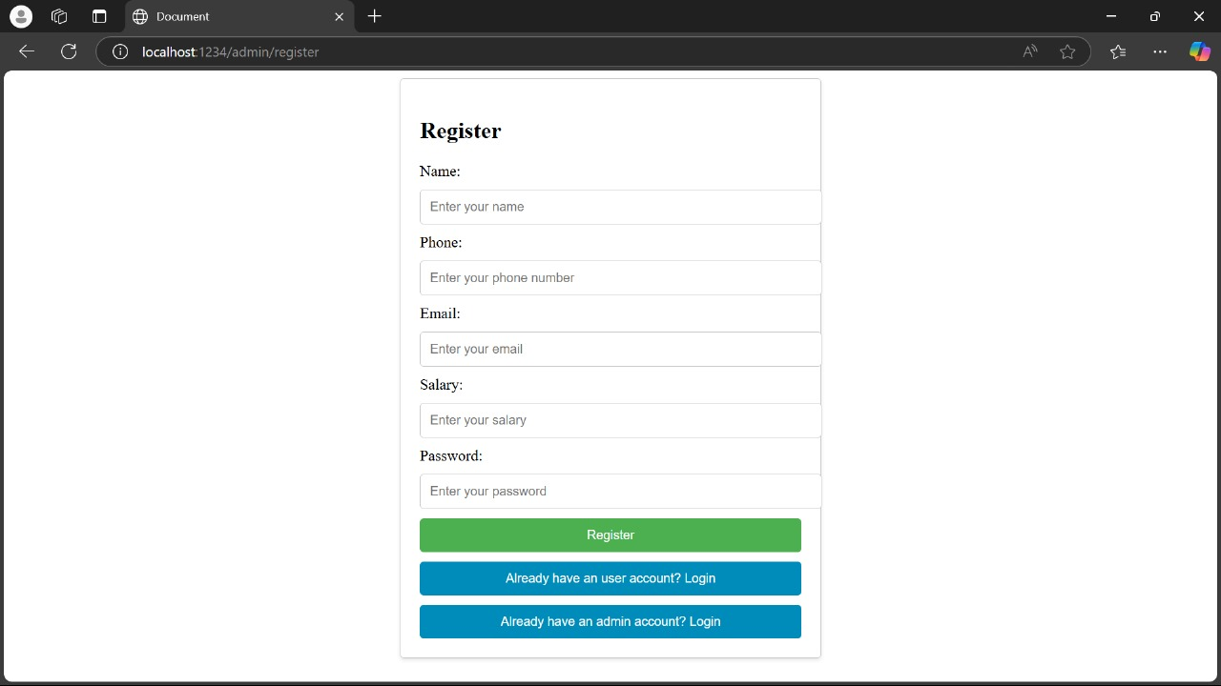
FORM DESIGN

Slide 10
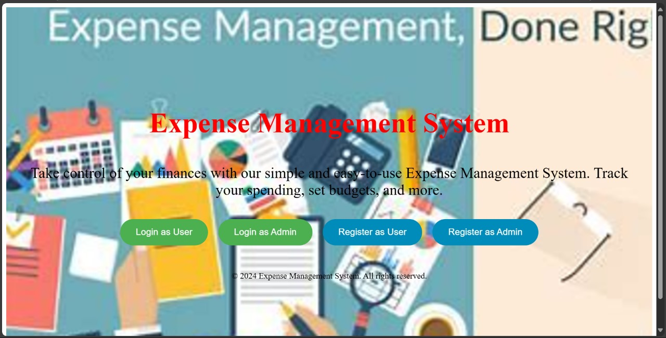
OUTPUT SNAPSHOTS

Slide 11
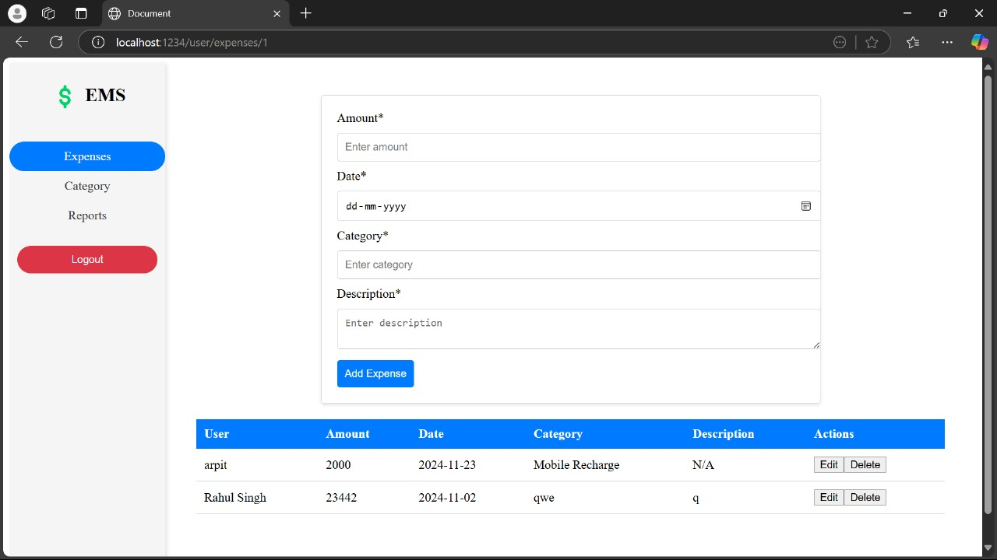
USER DASHBOARD

Slide 12
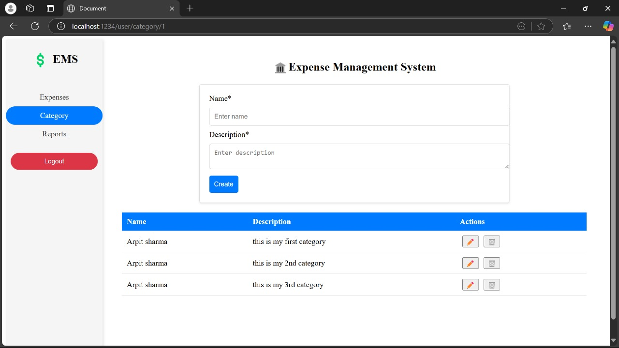
USER DASHBOARD

Slide 13
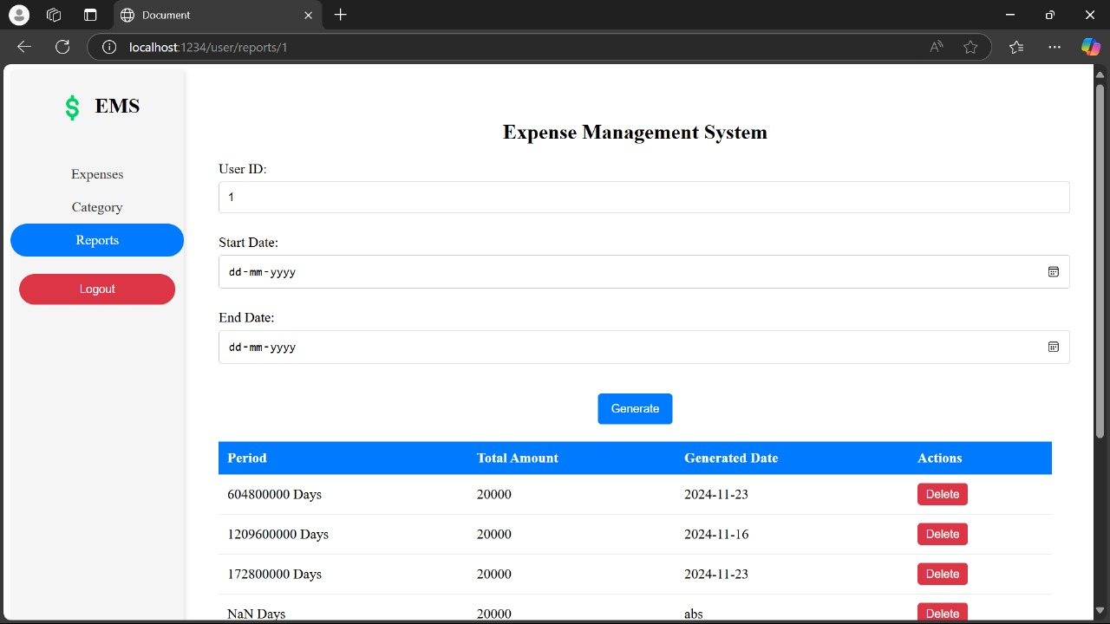
USER DASHBOARD

Slide 14
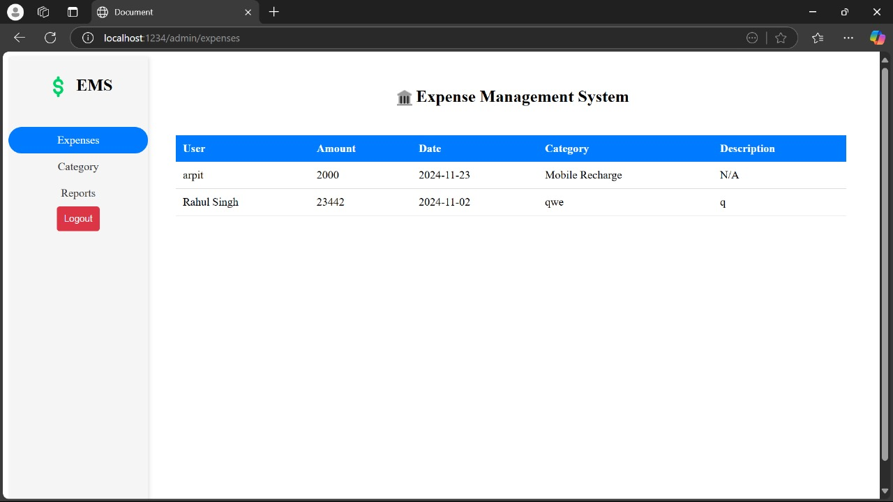
ADMIN DASHBOARD

Slide 15
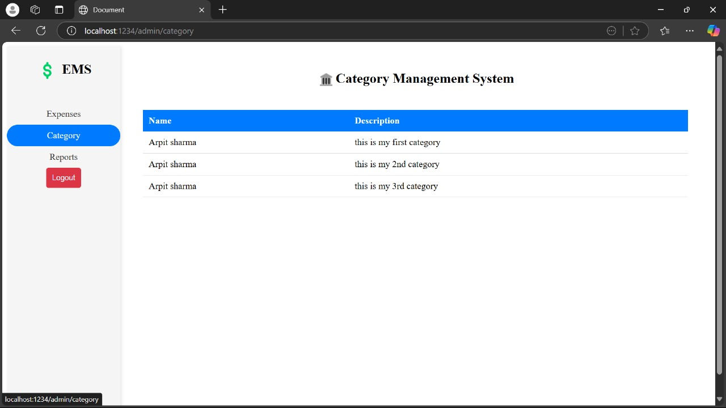
ADMIN DASHBOARD

Slide 16
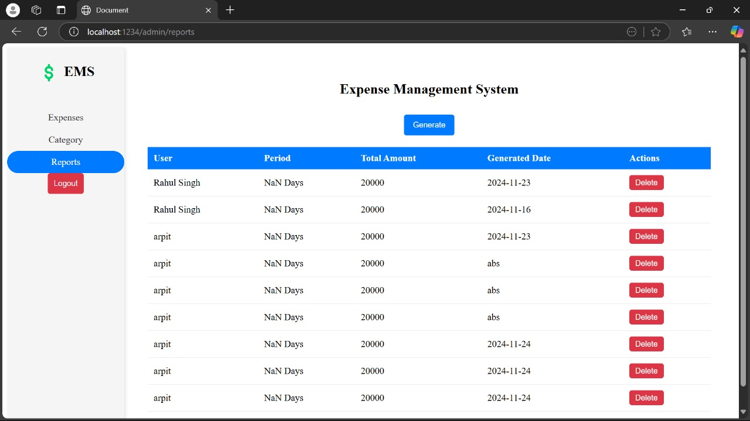
ADMIN DASHBOARD

Slide 17
FUTURE ENHANCEMENT
Mobile App Integration: Develop mobile versions of the system for seamless access on smartphones.
AI-driven Analytics: Advanced AI-based insights for predictive expense trends and budget forecasting.
Multilingual Support: Add support for multiple languages for global usage.
Customizable Dashboards: Provide more user-specific customization options on dashboards for better insights.

Slide 18
CONCLUSION
The Expense Management System offers an efficient, scalable, and secure solution for organizations to manage their finances. By automating tasks like expense tracking, reporting, and notifications, it reduces manual effort and improves accuracy. The system's architecture allows future scalability and the integration of advanced technologies like AI and Blockchain, making it an indispensable tool for modern businesses seeking to optimize their expense management processes.

Slide 19


